Slide 1
Advisory Report
Shrey Agrawal, Jiayi Chen, David Dai, Hong Doan

Slide 2
Build a Better Grinnell - Business Understanding
Build a Better Grinnell is a community-based initiative aimed at improving the quality of life in Grinnell, Iowa, USA
The initiative focuses on three key areas: economic development, community vitality, and environmental sustainability
Economic development initiatives include supporting local businesses, attracting new businesses to the area, and creating jobs
Community vitality initiatives aim to strengthen the social fabric of the community by supporting local arts and cultural events, improving public spaces, and creating opportunities for civic engagement and volunteerism
Environmental sustainability initiatives focus on promoting sustainable practices in the community, such as reducing waste and conserving energy, as well as supporting sustainable agriculture and local food systems
Build a Better Grinnell's goal is to create a vibrant, sustainable, and resilient community where people can thrive and enjoy a high quality of life
The initiative relies on the active involvement and collaboration of community members, organizations, and businesses to achieve these goals.

Slide 3
What Are We Tasked to Do
Open Ended….
The client wants us to perform data analysis and create visualizations to help them understand the issues related to the community of Grinnell, Iowa.
Provided several datasets, including responses from a Google form, a Grinnell College survey, business owner responses, and one-off questions.
Perform exploratory analysis techniques, including frequency counts, to help identify similarities in the issues being discussed.
The data will be used to compare to prioritization data and to identify areas where they can focus their efforts to build a better community.
The client is interested in finding categorical questions in the survey and in identifying how people's responses to one question may relate to their responses to another question.

Slide 4
Goals Statement
Meet with the client to discuss our findings and identify next steps and success criteria
Obtain, clean, and understand the survey data provided by the client for the community of Grinnell, Iowa.
Conduct preliminary data cleaning and research
Explore Python libraries for textual analysis and conduct a word frequency analysis to create a word cloud and graphs

Slide 5
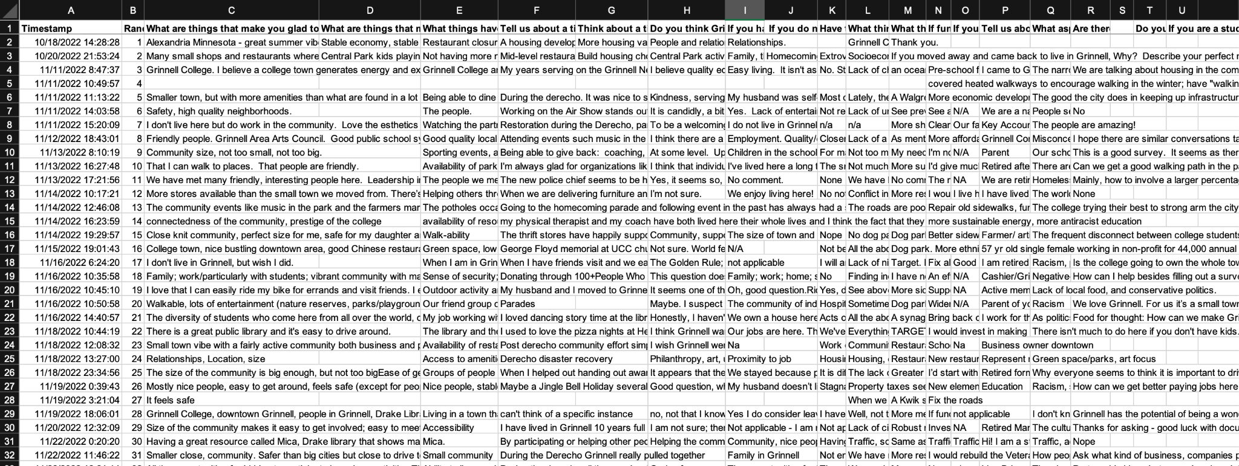
Snapshot of the raw data

Slide 6
Data Cleaning
The Data Cleaning Log is a record of the data cleaning process that was performed on the "Form Responses 1" sheet.
The main goals of the data cleaning process were to combine partial answers, append columns, delete unrelated answers, and ensure the accuracy and completeness of the data.
To achieve these goals, responses from other sheets were labeled with abbreviations and numbers, and similar or repeated questions were combined into a single column.
Unrelated answers were deleted, and two columns containing no responses were also deleted.
Potential issues were identified, including a response that was a question rather than an answer and a column containing two different questions that need to be carefully parsed.
The data cleaning process made the data more organized, streamlined, and focused, while also identifying potential issues that need to be addressed to ensure the accuracy and completeness of the data.

Slide 7
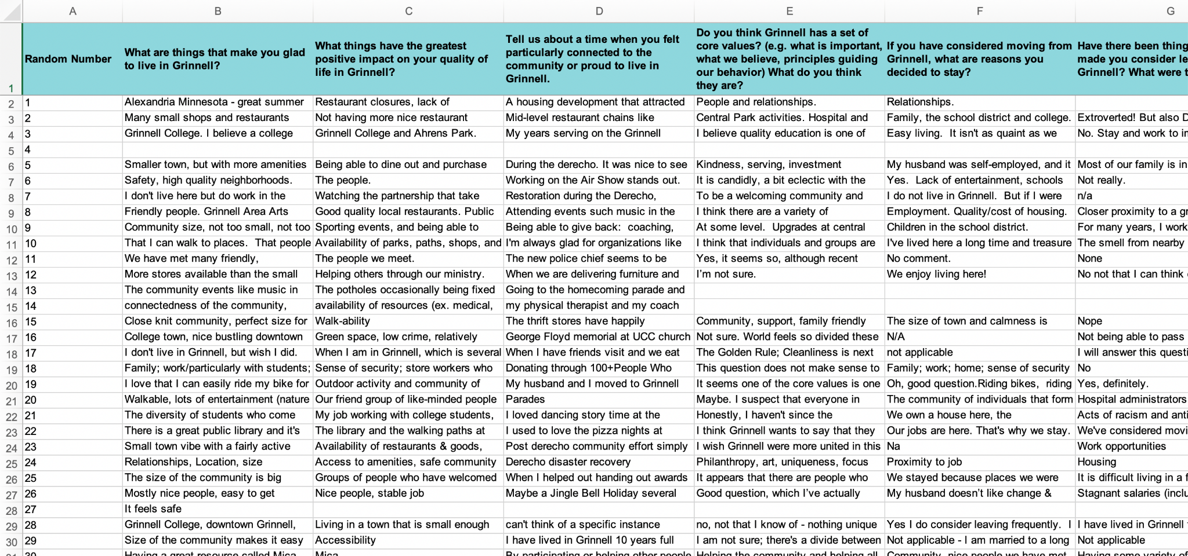
Snapshot of the cleaned data

Slide 8
Data Understanding
460 observations - 13 questions
1 - 367: Answers from the Online Form
MPR-1 - MPR-49: Miscellaneous Partial Responses
TPR-1111 - TPR-1121: Transcribed Paper Responses
GC-1 - GC-33: Grinnell College Students Responses

Slide 9
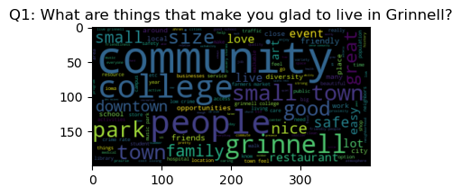
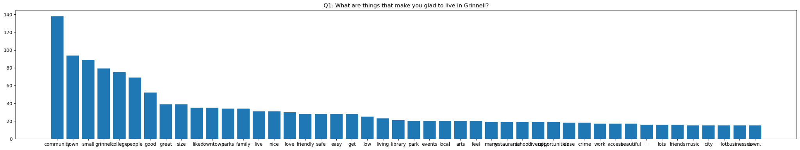
Progress / Results
Q1: What are things that make you glad to live in Grinnell?
community': 138, 'town': 94, 'small': 89

Slide 10
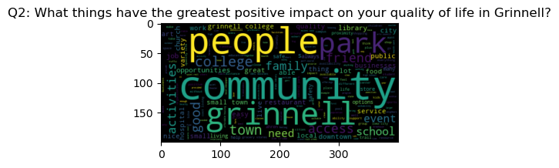
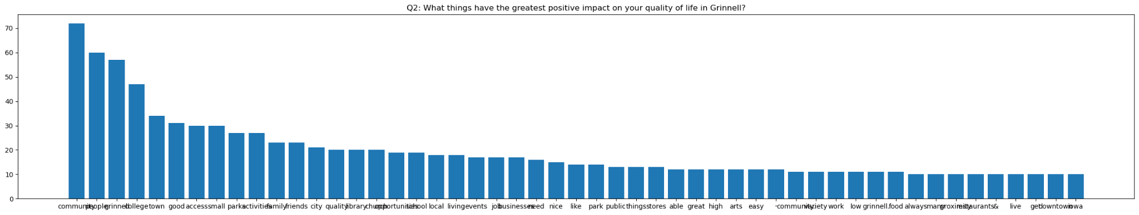
Progress / Results
Q2: What things have the greatest positive impact on your quality of life in Grinnell?
'community': 72, 'people': 60, 'grinnell': 57, 'college': 47

Slide 11
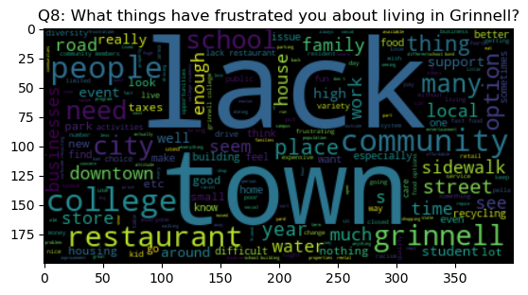
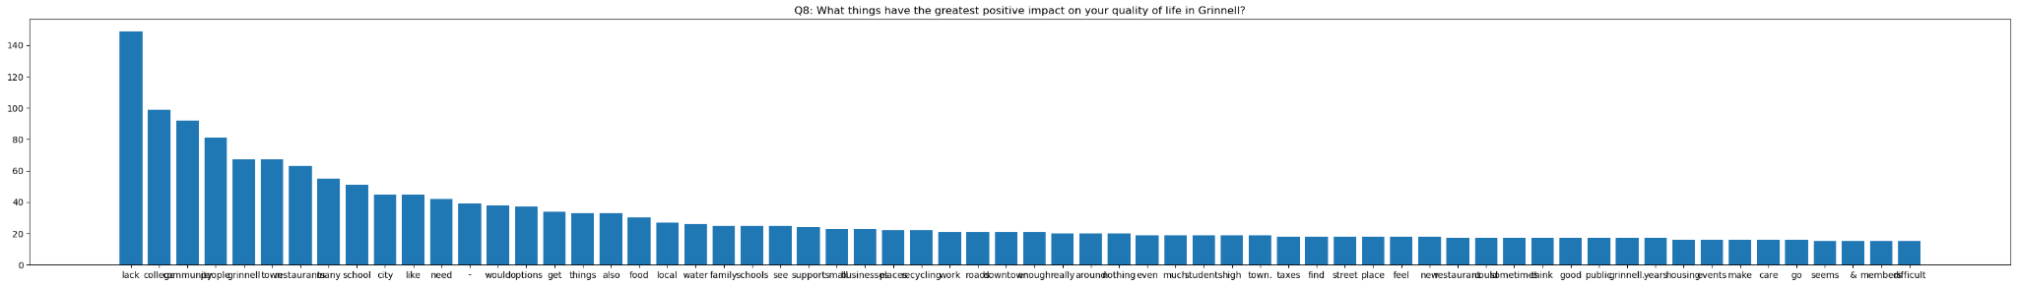
Progress / Results
Q8: What things have frustrated you about living in Grinnell?
'lack': 149, 'college': 99, 'community': 92

Slide 12
Python Packages Used
Pandas - data wrangling
Seaborn -visualization
WordCloud - visualization
matplotlib.pyplot - visualization
Nltk - identify the stopwords
re - splitting across multiple delimiters

Slide 13
Reflection
Meet with the client to discuss our findings and identify next steps and success criteria - Met
Obtain, clean, and understand the survey data provided by the client for the community of Grinnell, Iowa.- Met
Conduct preliminary data cleaning and research - Met
Merge the transcribed paper responses and Form Responses 1 to get a complete picture of the survey results.- Met
Explore Python libraries for textual analysis and conduct a word frequency analysis to create a word cloud and graphs- Met

Slide 14
Next Steps
Demographic Tracking/ Grouping:
Analyzing question (L) Tell us about you or your group. (club affiliation, profession, service group, etc.) Were you recruited by someone to take the survey? Who?
Filtering keywords from other questions that implied the demographic background of the participant
Word Network Analysis:
What are the frequency that different words being used together?
How do we further filter out unnecessary words in the answers?
Try to find correlations between questions. For ex. If someone gives a particular answer for a question, do they have a specific answer for another question

